Slide 1
ADOLESCENCE
EDUCATION PROGRAMME
An innitiative of the CBSE

Slide 2
AGENDA
The process of Growing Up
Understanding and Challenging Stereotypes and Discrimination
Prevention of Substance/Drug Misuse
Prevention of HIV and AIDS

Slide 3
SECTION 1
THE PROCESS OF GROWING UP

Slide 4
ADOLESCENCE
Stage of development which precedes adulthood
Spanning the ages between 10 and 19 years
Time of great physical change in young people
Characterized by rapid growth, hormonal change, changes in bodily appearance, changes in brain structure

Slide 5
Special attributes that mark adolescence:
Rapid physical growth and development
Physical, social and psychological maturity, not necessarily at the same time
Sexual maturity and onset of sexual activity
Experimentation
Development of adult mental processes and adult identity
Transition from total socio-economic dependence to relative independence

Slide 6
Brain vs. Hormones
Two main elements that affect maturity of both body and emotions
Hormonal changes lead to and guide the body through puberty, resulting in sexual maturity
The brain develops and changes throughout childhood and adolescence

Slide 7
Adolescence and Sleep
Physiological need for more sleep, probably because they are growing rapidly
Change to the secretion of the hormone melatonin, which controls sleep

Slide 8
Physical changes during Adolescence

Slide 9
PHYSICAL CHANGES | GIRL | BOY
Growth Spurt | Starts at about 10 years of age and peaks at 12, weight gain, broadening of the hips | Starts at about 12 years of age, weight gain, Growth of arms, legs and penis
Activation of Oil and Sweat Glands | Increased production of androgen hormones in both sexes leads to increase in skin thickness and stimulates the growth of sebaceous glands
Voice | No significant change | Enlargement of the larynx, deepening of the voice
Growth of Hair | Growth of pubic hair, body hair become coarser and there is growth of hair in the armpits | Appearance of pubic hair, hair growth on the chest, the armpits and on the face
Breasts | Starts between 8 and 13 years and is completed between 13 and 18 yrs | Sometimes the breast can become prominent
Reproductive & Sexual Organs | Reproductive and sexual organs attain maturity during adolescence

Slide 10
Emotional Changes
Strong feelings and intense emotions at different times.
Moods might seem unpredictable.
More self-conscious, especially about physical appearance and changes
Invincible” stage of thinking and acting as if nothing bad could happen to him

Slide 11
Social Changes
Searching for identity
Seeking more independence
Seeking more responsibility, both at home and at school
Looking for new experiences
Thinking more about “right” and “wrong”

Slide 12
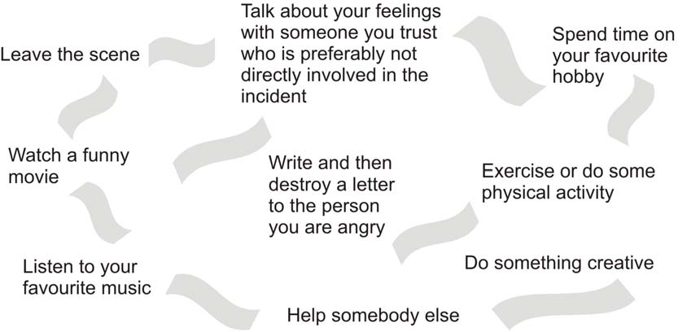
Anger Reducing Techniques : to get ‘rid’ of anger
R = Recognize your anger signals and accept that you are angry
I = Identify a positive way to analyze the situation
D = Do something constructive to calm down

Slide 13
Stress Coping Activities
Laugh hard
Breathe deeply
Listen to your favourite music
Feel the morning sunshine
Practice shrugging
Yoga

Slide 14
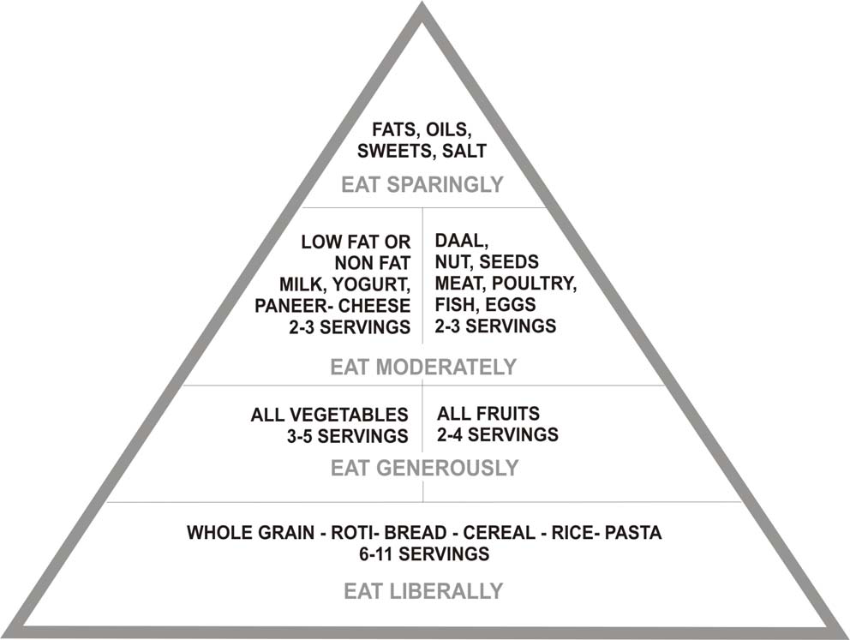
Nutritional Needs of Adolescents

Slide 15
Body Mass Index (BMI)
Measure of body weight to height
Known as Quetelet’s Index
Use to determine if a person is underweight, optimum weight, or over weight
BMI= Weight in kilograms/ height in meters²
BMI | CATEGORY
<18.5 | Under Weight
18.5 – 24.9 | Normal Weight
25 – 29.9 | Over Weight
>30.0 | Obese

Slide 16
Some Common Nutritional Disorders
Nutritional Anaemia
Bulimia Nervosa
Anorexia Nervosa

Slide 17
Early Marriage
Legal age at marriage
18 years for girls and 21 years for boys
National Family Health Survey(2005-06) show that 27% young women and 3% young men in the age group 15-19 were married at the time of the survey
30% women in the age group 15-19 had a live birth by the age of 19 years

Slide 18
Adolescent Pregnancy
Leads to great health risks to the teenage mother and her child
Mother is more likely to suffer from anemia
Chances of prolonged labour that can result in severe damage to the reproductive tract
Low birth-weight babies
Increases the risks of maternal and child morbidity and mortality

Slide 19
SECTION 2
UNDERSTANDING AND CHALLENGING STEREOTYPES AND DISCRIMINATION

Slide 20
Sex vs. Gender
Sex
Biologically determined
Gender
Influenced by the interaction of biological, psychological, social, cultural and historical factors
A concept made by society, teaching us how men and women should behave and how they are expected to act
Roles and qualities vary from society to society

Slide 21
Changing Gender Roles
Most are aware that gender roles cannot remain fixed and they are eager to be part of the change
Most school-going adolescents feel positive about girls studying and entering various careers
Girls and boys both want a partner who will understand

Slide 22
Burden of Work on Women
The data below from a special study done by the Central Statistical Organization of India (1998-1999)
State | Women paid (work hours per week) | Women unpaid (housework hours per week) | Women (total) | Men paid (work hours per week) | Men Unpaid (housework hours per week) | Men (total)
Haryana | 23 | 30 | 53 | 38 | 2 | 40
Tamil Nadu | 19 | 35 | 54 | 40 | 4 | 44

Slide 23
Sex Selection
Use of ultrasound technology has become the most common mode of sex determination
Child Sex Ratio is calculated as the number of girls per 1000 boys in the 0-6 years age group
In India, the ratio has shown a sharp decline from 976 girls to 1000 boys in 1961 to 914 as per the 2011 census
The practice of dowry and the tag of ‘paraya dhan’ further translate into daughters being seen as liabilities

Slide 24
Domestic Violence Act, 2005
Domestic violence - physical abuse, sexual abuse, verbal and emotional abuse as well as economic abuse
Ensures a woman’s right to reside in shared household
Ensures that a court may pass a protection order
Provides for the women’s right to her “stridhan” or any other property

Slide 25
Seeks the appointment of Protection Officers and service providers by the State
Section 498 A provides for a criminal complaint in case of domestic violence
Ensures that police arrest the perpetrators after preliminary enquiries
Seeks to ensure a victim’s access to necessary services including health services

Slide 26
Sexual Abuse
Sexual harassment is illegal and reportable under the legal provisions in India
There is also a law dealing specifically with `sexual harassment in the workplace
Due to the stigma attached to rape, most rape victims do not report the cases
Schools have a very important role in preventing sexual harassment and abuse

Slide 27
Parent and teacher bodies like the Parent Teacher Associations may be able to establish mechanisms to facilitate reporting of sexual harassment and to support those who complain
Most importantly, schools can build an attitude in children that has a zero-tolerance towards any form of abuse or harassment
This is possible only in an atmosphere of genuine learning and good motivation

Slide 28
SECTION 3
PREVENTION OF SUBSTANCE/DRUG MISUSE

Slide 29
Types and effects of substance use
Group | Drugs | Effect the user feels
Stimulants | Benzedrine Dexedrine and Methedrine, Cocaine, Nicotine,Tobacco, Caffeine, Gutka, Pan masala | Accelerate the brain. Long term use may result in cancer of the lungs, mouth, larynx, oesophagus, bladder, kidney or pancreas
Depressants | Alcohol, Barbiturates Tranquilizers, inhalants | Slow down activity of the brain. Inflamed stomach and pancreas
Sedatives | Hypnotic like Mandrax, Doriden | Deep sleep, loss of consciousness and even death
Narcotic/ Analgesics | Opium, Morphine, Codeine, Heroin, Brown Sugar, Methadone | Reduces pain and anxiety. Higher doses lead to sedation, nausea and unconsciousness
Cannabis | Bhang (Marijuana), Ganja, Charas | Leads to relaxation, drowsiness, talkativeness and unconsciousness
Hallucinogens | LSD, Mescaline, Psilocybin, Cannabis | Distort the way in which individuals see, hear and feel, strong negative effects and psychiatric complications
Inhalants | Glue, gassing, sniffing, chemo. | feelings of euphoria that are characterized by lightheadedness, exhilaration and vivid fantasies, slows down body Functions

Slide 30
Consequences of Substance Misuse
Short-term Effects:
False sense of well-being and a pleasant drowsiness. Some of the
Distorted vision, hearing and coordination, impaired judgment, bad breath and hangovers
Long-term Effects:
Progressive damage to different body organs
impairs both physical and mental functioning leading to compromised quality of life
include irregular eating habits, poor hygiene resulting in poor health and low immunity

Slide 31
Prevention of substance misuse:
Developing skills to manage peer pressure
Different ways of dealing with negative peer pressure are saying ‘No’ assertively
Empowered with adequate information and skills
Encourage the adolescents to get engaged in socially productive activities

Slide 32
Substance Misuse and the Law:
Prohibition of smoking in public places
Prohibition of advertisement of cigarette or other tobacco products
Sale of cigarettes and other tobacco products to a person below the age of 18 years is not
Allowed sale of cigarettes within 100 meters of a school is also banned

Slide 33
Laws pertaining to Alcohol include
Licensing Laws regulate retail supply
Legislation on drunkenness, defining intoxication as an offence under certain circumstances
Road traffic legislation – makes driving while under the influence of alcohol an offence when blood alcohol level exceeds a certain value (30 mg/100 ml of blood) detected by breath analyzer
Minimum age of drinking varies in different states

Slide 34
Treatment for Substance Misuse
Adopting a combination of approaches, including medication, behavioral changes and health care for physical and psychological symptoms
Professional counseling or Drug De-addiction
interventions for prevention must begin early
Teachers should try to share the problems, academic and personal of the learners and guide them

Slide 35
SECTION 4
PREVENTION OF HIV AND AIDS

Slide 36
What is HIV?
HIV stands for:
H : Human (This virus survives only in human body)
I : Immunodeficiency (Virus produces weakness or inadequacy of the body’s main defense mechanism, the immune system)
V : Virus

Slide 37
Human Immunodeficiency Virus (HIV)
Belongs to a family of viruses called retroviruses.
Tiny, a thousand times smaller than the thickness of a hair
Attaches itself to the genetic material of the human cells it has infected
Hard for either the body or drugs to deal with it, without destroying the cell itself

Slide 38
What is AIDS?
Acquired : Not genetically inherited but one gets it from an infected person
Immune Deficiency : Weakness or inadequacy of the body's main defense mechanism, the immune system.
Syndrome : Not just one disease or symptom but being present in the body as a group of diseases or symptoms
Diagnosed by blood test at an authorized laboratory

Slide 39
How is HIV transmitted?
Unprotected Sex (most common)
Infected mother to new-born child
Blood
How is HIV not transmitted?
Shaking hands, kissing & hugging
Sharing cups, plates and other eating utensils
Sharing toilet and bathroom
Through coughing or sneezing
Donating blood to the Blood Bank
Bites by insects

Slide 40
HIV Prevention
Responsible Sexual Behaviour
Use of Safe Blood and Instruments
In case of Mother-to-Child Transmission (MTCT), Termination of pregnancy used to be the only solution to prevent vertical transmission

Slide 41
HIV and AIDS Prevalence in India
Third largest number of people living with HIV/AIDS
Estimated 24 lakh people living with HIV/AIDS with an adult prevalence of 0.31 percent in 2009
One in every 1000 young people in the age group 15-24 is HIV positive

Slide 42
Vulnerability of Adolescents
Adolescents are more vulnerable to HIV infection because of the following reasons:
Lack of correct knowledge about transmission of HIV
Less likely to recognize potentially risky situations
Negative peer pressure
Lack of access to youth friendly services
Lack of life skills needed to make informed and responsible decisions

Slide 43
What can be done:
Providing the youth with correct information on possible ways in which they can get infected with HIV
Establishing a positive and sharing relationship with their parents
Supportive environment in school and peers who do not engage in risky behaviors or misguide others

Slide 44
Diagnosing HIV Infection
Most people with HIV show no symptoms of disease
Asymptomatic HIV infection is a phase of HIV/AIDS during which there are no symptoms of HIV infection
The window period represents the period of time between initial infection with HIV and the time when HIV antibodies can be detected (6–12 weeks)
HIV Testing : ELISA, WESTERN BLOT, RAPID TEST

Slide 45
Integrated Counselling and Testing Centre, ICTC
An Integrated Counselling and Testing Centre (ICTC), is a place where a person is tested for HIV and counselled
Confidential testing and counseling for HIV
Linking individuals with other HIV prevention, care and treatment services
Provision of basic information on modes of transmission and prevention of HIV/AIDS
On detection of sero-negative case, identifying risk behaviors and providing counseling to help them stay negative

Slide 46
Reproductive Tract Infections - RTIs
Occur in the reproductive tract of both men and women
Caused by bacteria, viruses or protozoa
RTIs include all infections of the reproductive tract whether transmitted sexually or not
Practice of proper genital hygiene can prevent RTIs
For cure of RTIs, patient should seek advice and treatment of qualified doctors

Slide 47
Sexually Transmitted Infections - STIs
Transmitted from one partner to another during unprotected sexual activity
Common STIs are Gonorrhoea, Chlamydia, Syphilis and HIV etc
STIs put a person at a greater risk of getting and transmitting HIV
Most STIs are easy to treat, if they are detected and treated early

Slide 48
Symptoms of some prevalent STIs
STIs | Symptoms
Gonorrhea | vaginal discharge, burning or painful urination, pus-like discharge from the penis (in boys)
Chlamydia | similar to those of gonorrhea
Syphilis | appearance of a chancre (painless ulcer) at the site of initial exposure
Herpes Simplex Virus | burning and itching of the genital area, blisters or sores on the genitals, discharge from the vagina or penis
Human Papilloma Virus (HPV) | warty growths of HPV can appear on the external or internal reproductive organs
Human Immunodeficiency Virus (HIV) | rash, fever, enlarged lymph nodes, and a flu-like illness, weight loss, chronic cough, fever, fatigue, chronic diarrhea

Slide 49
THANKS!
Any questions?
Anahita Singh
anahita@udayapulicschool.edu.in

